Slide 1


Human Resources Dataset Analysis

Slide 2

Table of Content
01
05
Agenda
EDA
02
Introduction
06
Recommendations
03
Challenges
07
04
Questions
Methedology

Slide 3

Introduction
HR today is about more than just hiring and payroll—it's a key part of shaping company success. From keeping employees happy to building strong teams and planning for the future, HR plays a big role.
Understanding HR data helps companies:
Keep good employees and boost satisfaction
Make smart choices about promotions and salaries
Create a fair and productive work environment
Plan for future growth with the right people in the right roles
As businesses grow and change, using HR insights is essential to stay competitive and successful

Slide 4

Challenges
Data Quality & Accuracy Incomplete, outdated, or inconsistent employee records can lead to poor decisions.
Lack of Standardization Inconsistent formats or definitions (e.g., job titles, departments) make it hard to compare or combine data.
Change Resistance Teams may be hesitant to rely on data over intuition, especially in people-centered roles.

Slide 5

Methodology

Slide 6


Overview
This dataset provides structured insights into various aspects of an organization’s workforce, including:
Employee Performance – Tracks performance evaluations and reviews.
Satisfaction Levels – Links employee satisfaction to workplace factors.
Education & Qualifications – Captures educational background and its impact.
Salary Distribution – Provides salary ranges for different job roles.

Slide 7
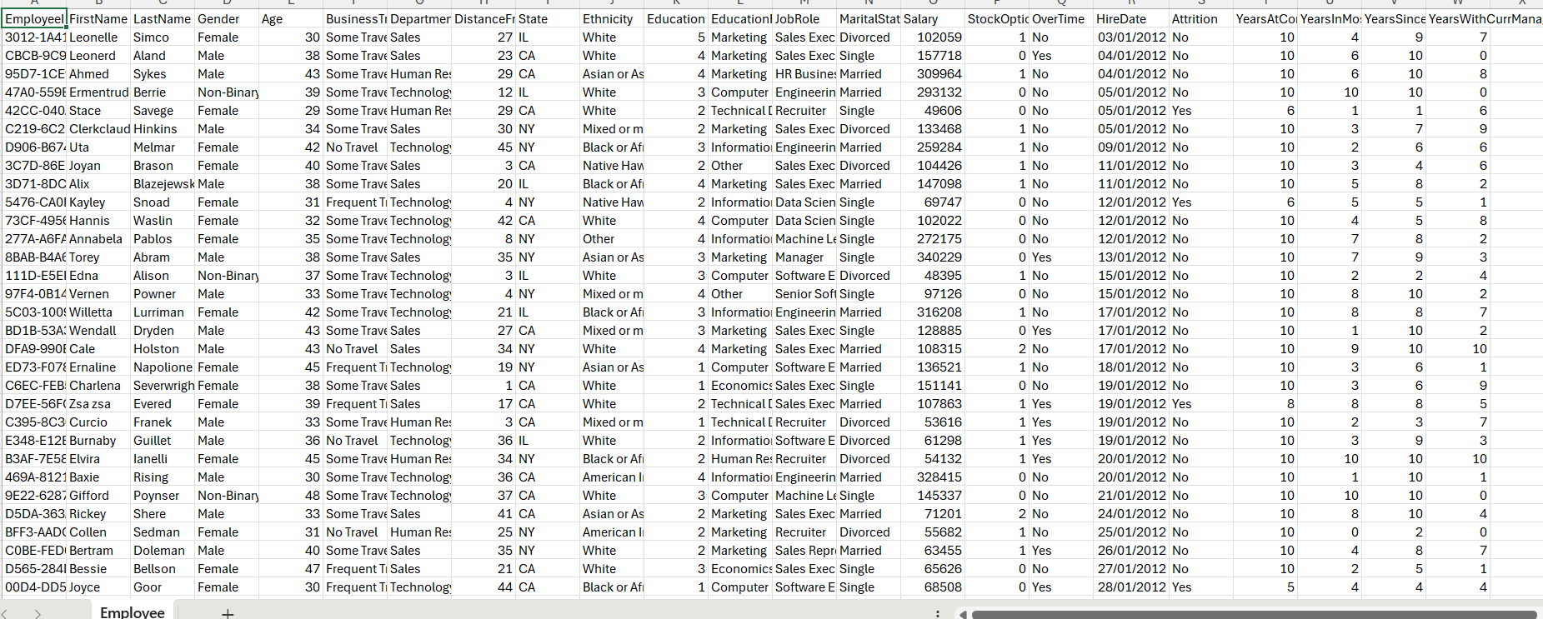
Data OverView

Slide 8
Employee Data
Employee ID
FirstName
LastName
Gender
Age
Business Travel
Department
Distance From Home (KM)
State
Ethnicity
Education
Education Field
Job Role
Marital Status
Salary
Stock Option Level
Over Time
Hire Date
Attrition
Years At Company
Years In Most Recent Role
Year Since Last Promotion
Years With Curr Manager
Rows: 1471 rows

Slide 9
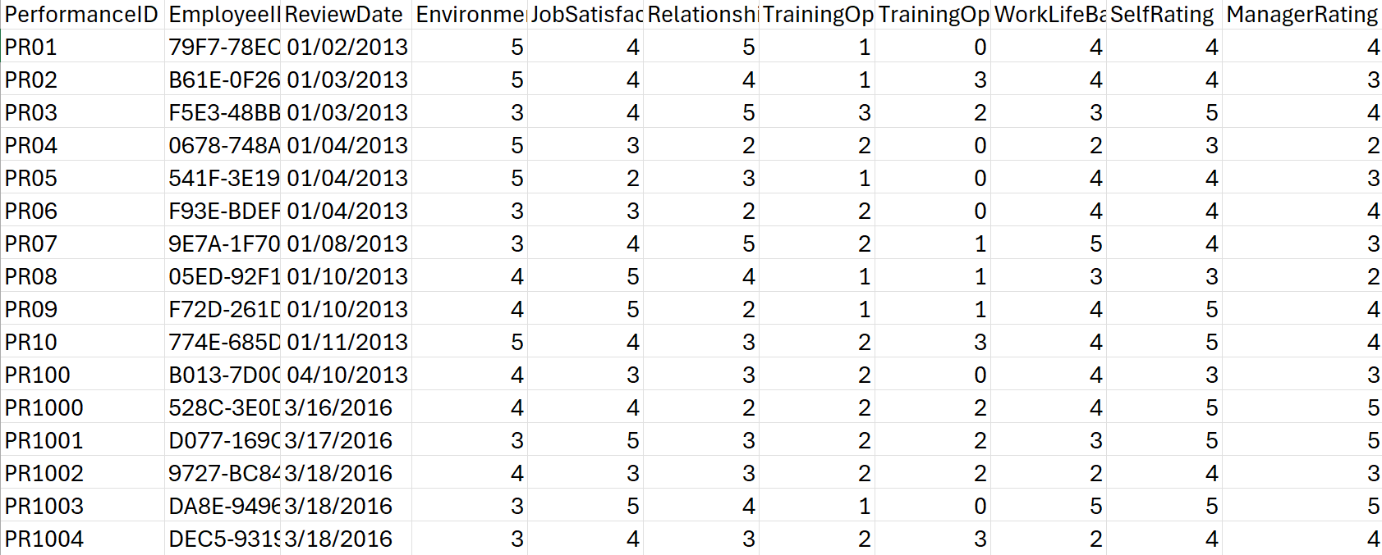
Data OverView

Slide 10
Performance
Performance ID
Employee ID
Review Date
Environment
Satisfaction
Job Satisfaction
Relationship Satisfaction
Training Opportunities Within a Year
Training Opportunities Taken
WorkL life balance
Self Rating
Manager Rating
Rows: 6710 rows

Slide 11
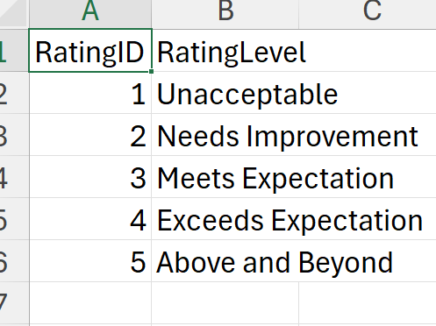
Data OverView

Slide 12
Data OverView

Slide 13
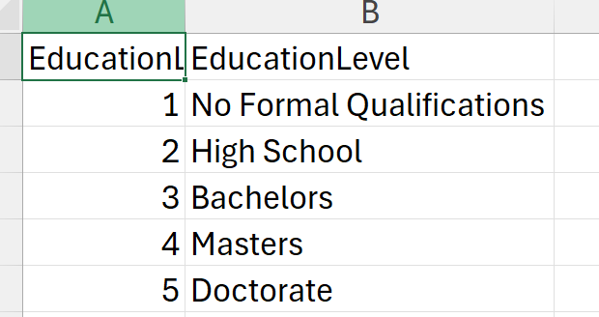
Data OverView

Slide 14
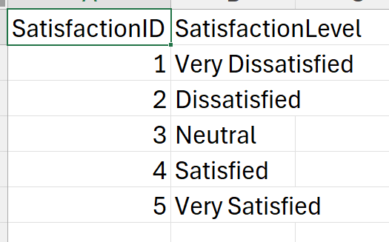
Data OverView

Slide 15

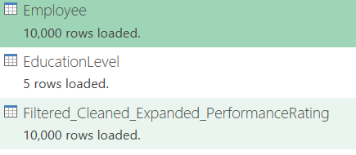

After Prompt Generation

Slide 16
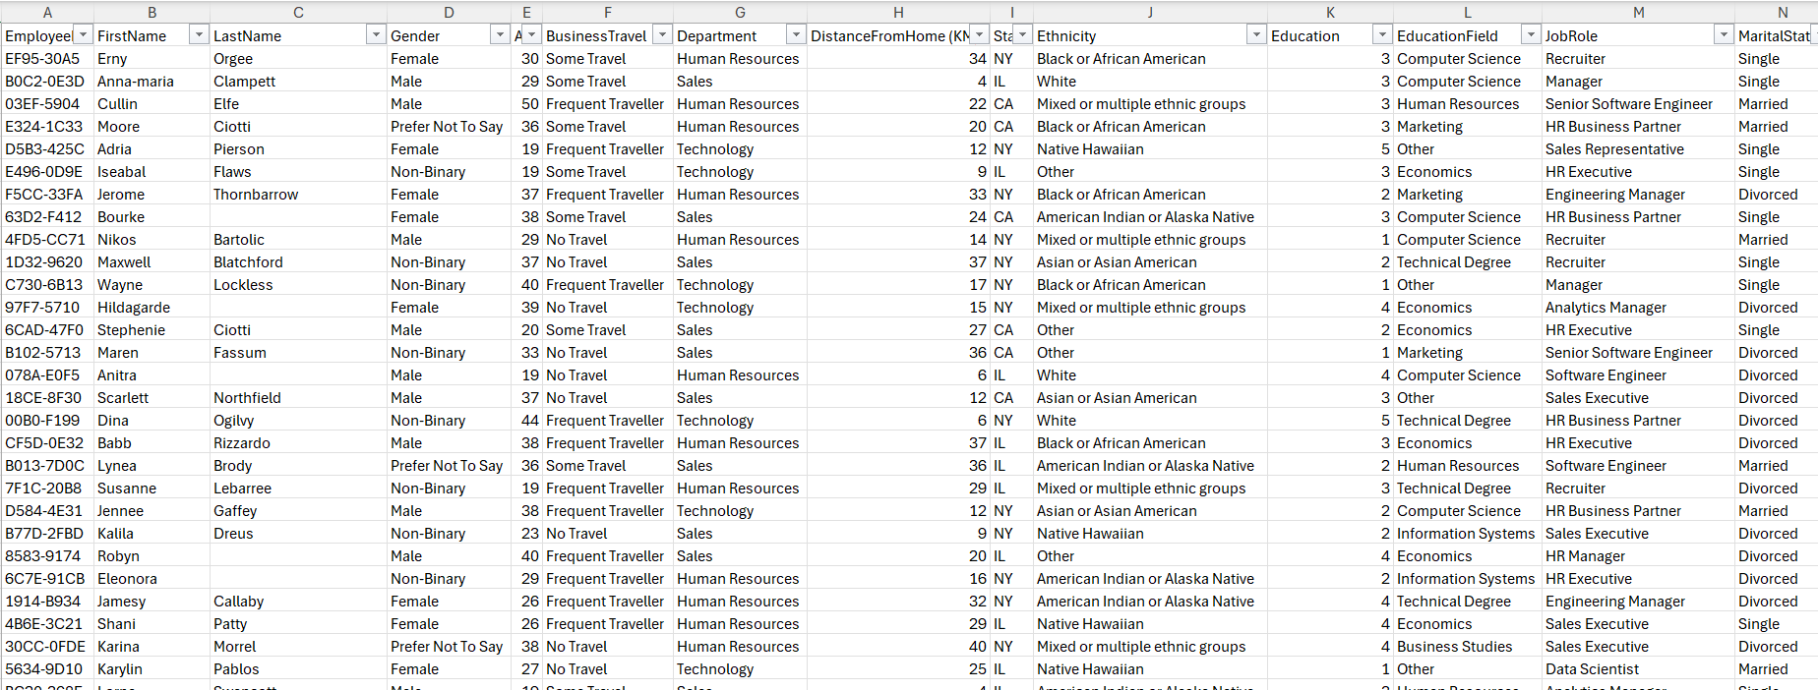
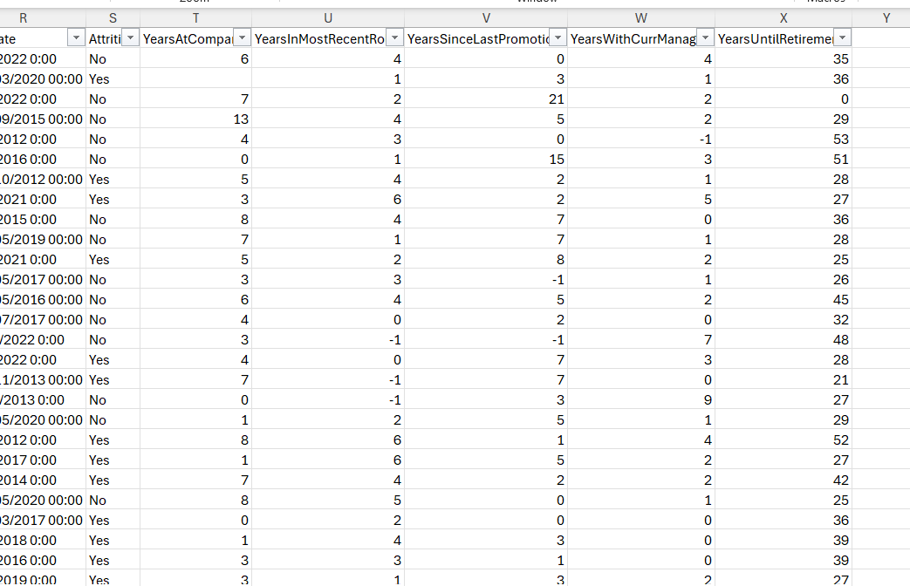
Regeneration Of Data

Slide 17
Data issues
1️⃣ Missing Values – Some fields contained empty or missing values.
2️⃣ Outliers in Salaries & Other Columns – Extreme values distorted the dataset.
3️⃣ Years at Company vs. Years with Current Manager – Some employees had more years with their manager than at the company, which was illogical.
4️⃣ Hire Date vs. Review Date Issues – Some review dates were earlier than hire dates, causing timeline inconsistencies.
6️⃣ General Data Inconsistencies – Misalignment between employee records and generated data led to inaccuracies.

Slide 18
01
02
03
Fixed Review Date Issues – Adjusted review dates to always be after hire dates
Treated Outliers – Applied upper/lower bound capping to keep values within a reasonable range
Adjusted Salary Ranges – Used the original dataset to set realistic min/max thresholds and capped extreme value
04
05
06
Calculated Attrition Rate – Derived insights by measuring employee turnover trends.
This structured approach improved data accuracy, consistency, and reliability for analysis.
Corrected Experience Mismatch – Ensured years with manager did not exceed years at the company
Aligned Employee Records – Ensured consistency across datasets for logical accuracy.
07
Handled Missing Values – Replaced using mean or median based on data distribution.
Handling issues
#

Slide 19

Methods
1
Understanding the Data
2
Data Cleaning (Using Power Query & Other Methods
3
Identifying Outliers & Data Distribution
4
Capping Outliers to Normal Ranges
5
Data Consolidation & Modeling
6
Producing Insights using DAX and visulization using Excel

Slide 20
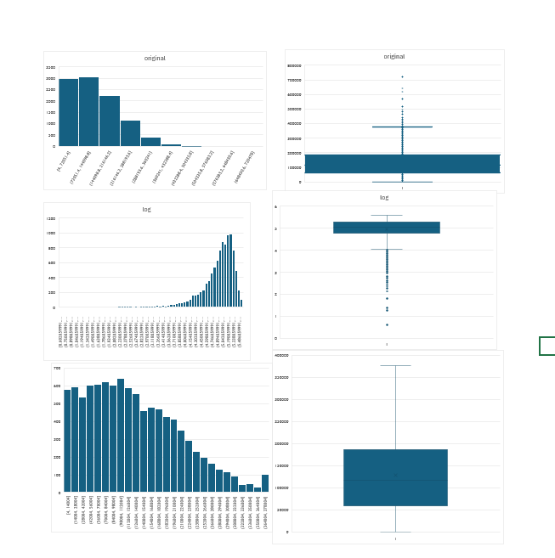
Salary

Slide 21
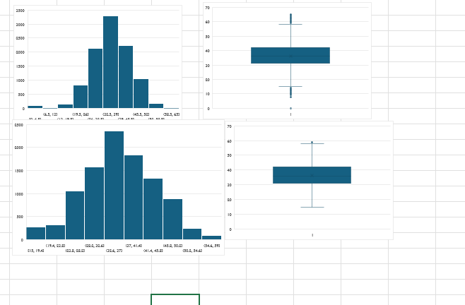
Retirement

Slide 22
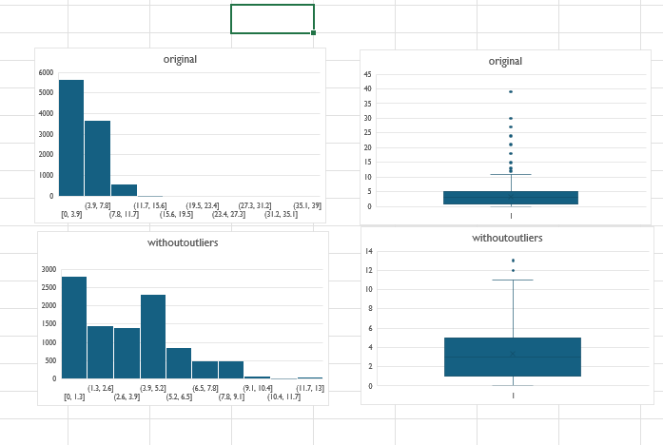
Promotion

Slide 23
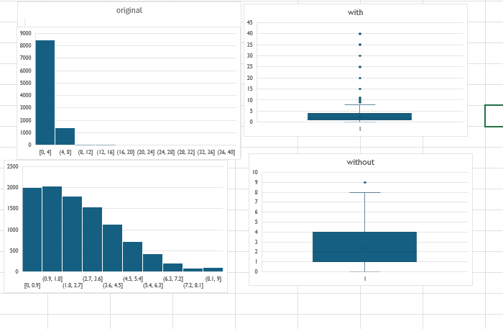
Most Recent Role

Slide 24
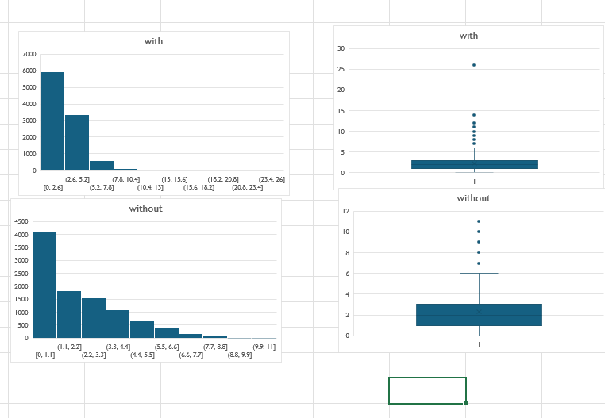
Most current Role

Slide 25
Current Manger

Slide 26
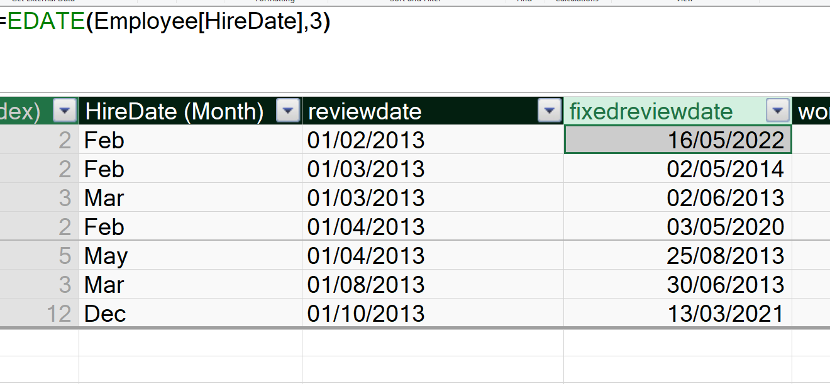
Review Date

Slide 27
AGE

Slide 28
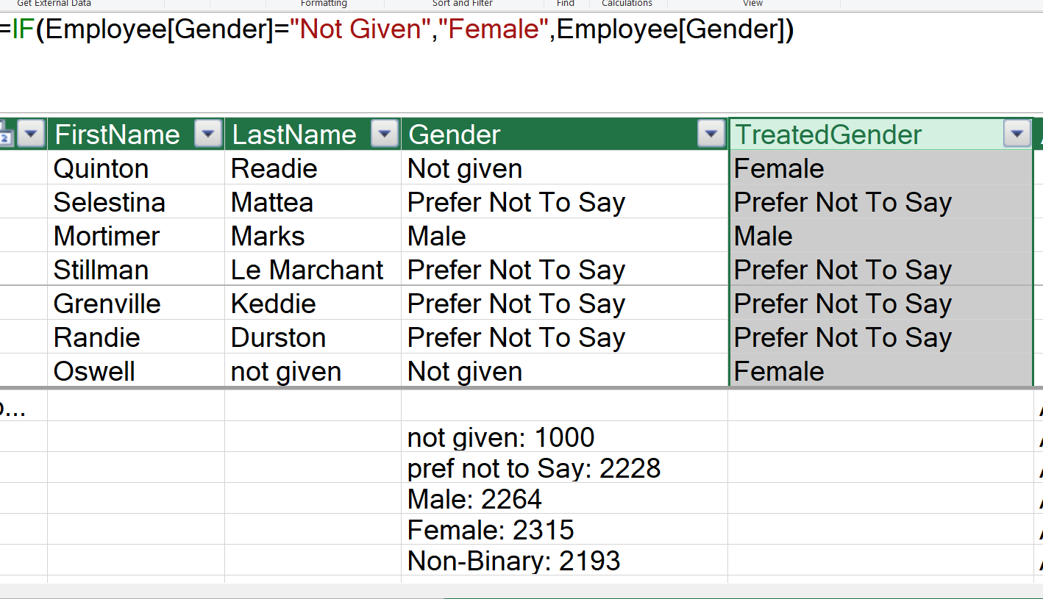
Gender

Slide 29
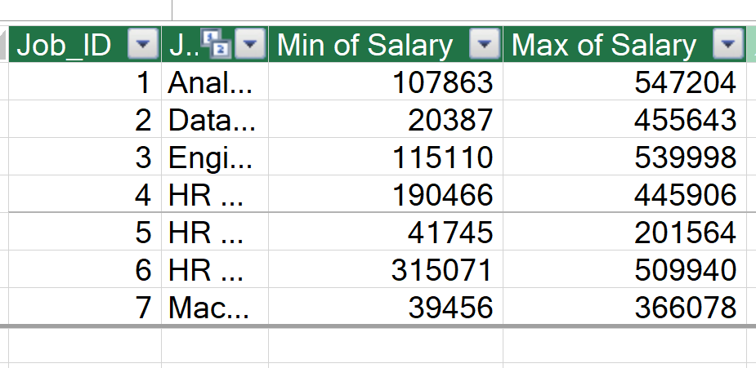
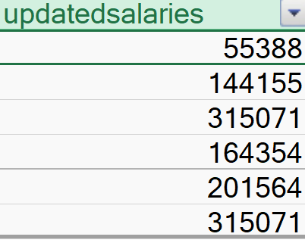
Salary

Slide 30
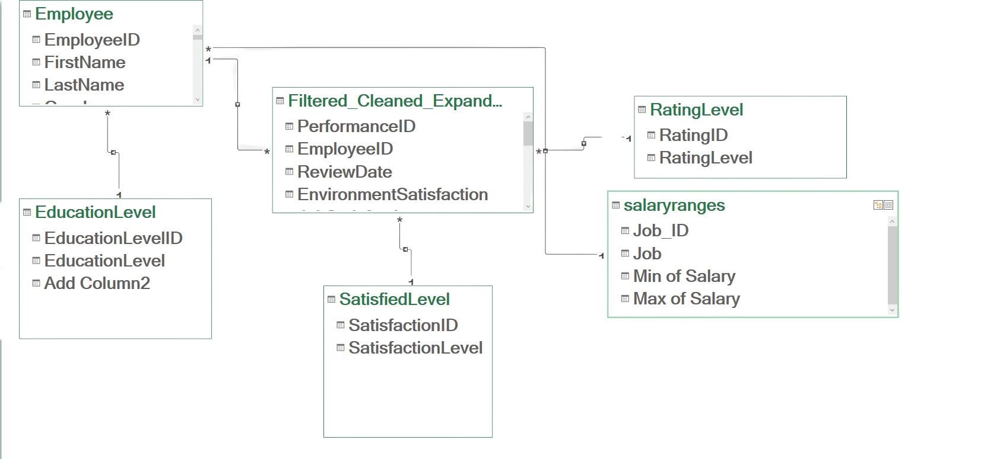
Data Model

Slide 31


Address Salary & Compensation Gaps
Ensure all employees receive performance-based bonuses or stock options to enhance job satisfaction.
Adjust salary structures based on performance trends and industry benchmarks to maintain competitiveness.
Identify salary outliers and rectify inconsistencies in pay distribution.
RECOMMENDATIONS
Strengthen Data Collection & Validation
Ensure consistent data entry to prevent missing values in crucial fields like promotions, tenure, and manager records.
Implement automated data validation rules at the point of collection to reduce errors.
Conduct regular audits to ensure historical data remains complete and accurate.

Slide 32

Thank You

